Slide 1
Lecture 11
Requirements Modeling:
  Behavior Model
BSSE (Software Engineering-I) SZABIST-Islamabad

Slide 2
Behavior Model
Behavioral models are models of the dynamic behavior of a system as it is executing. They show what happens or what is supposed to happen when a system responds to a stimulus from its environment.
You can think of these stimuli as being of two types:
  Data Some data arrives that has to be processed by the system.
  Events Some event happens that triggers system processing. Events may have associated data, although this is not always the case.
Example: State Diagram, Sequence Diagram
BSSE (Software Engineering-I) SZABIST-Islamabad

Slide 3
State Diagram
State diagram: Depicts data and behavior of a single object throughout its lifetime. Or
A state diagram, also called a state machine diagram or statechart diagram, is an illustration of the states an object can attain as well as the transitions between those states in the Unified Modeling Language (UML).

Slide 4
Components of State Diagram
Components
  States: a condition of an object
  Events: a state changing occurrence
  Transitions: from one state to the next, occur when the associated event occurs
Example: Lock
  States: Lock, unlock
  Event: Key Inserted

Slide 5
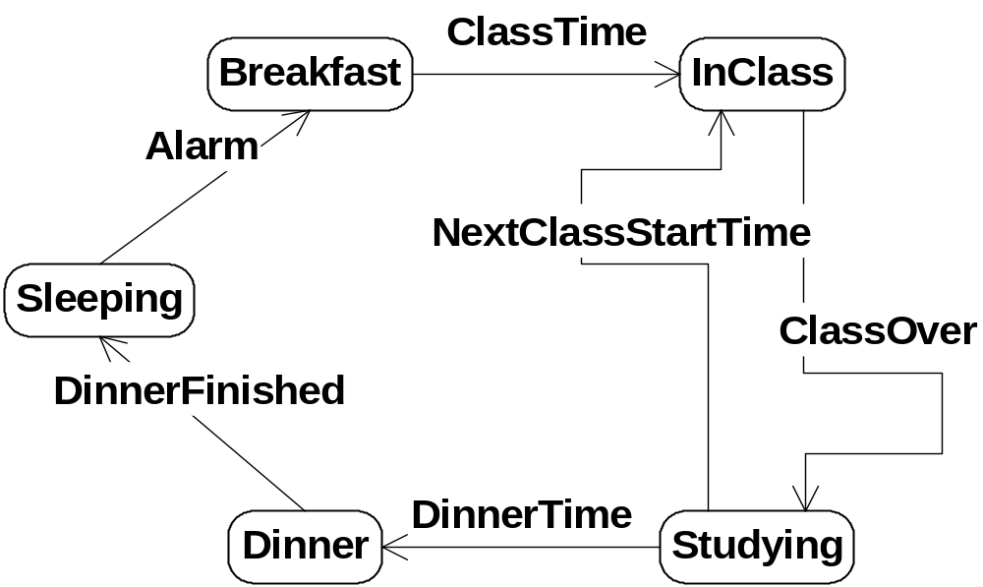
State Diagram Representation
Diagram:
BSSE (Software Engineering-I) SZABIST-Islamabad

Slide 6
State
State is a vertex which models a situation during which some (usually implicit) invariant condition holds.
The UML defines the following kinds of states:
  simple state,
  composite state,
BSSE (Software Engineering-I) SZABIST-Islamabad

Slide 7

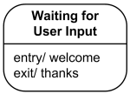
Simple State
A simple state is a state that does not have substates - it has no regions.
Simple state is shown as a rectangle with rounded corners and the state name inside the rectangle.
BSSE (Software Engineering-I) SZABIST-Islamabad

Slide 8
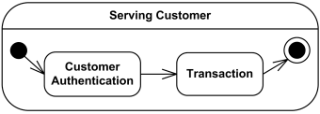

Composite State
Composite state is defined as state that has substates (nested states). Substates could be sequential (disjoint) or concurrent (orthogonal). And it contains one or more regions.
Simple composite state contains just one region.
BSSE (Software Engineering-I) SZABIST-Islamabad

Slide 9
Pseudostates
Pseudostates are typically used to connect multiple transitions into more complex state transitions paths. For example, by combining a transition entering a fork pseudostate with a set of transitions exiting the fork pseudostate, we get a compound transition that leads to a set of orthogonal target states.
Pseudostates include:
  initial pseudostate
  terminate pseudostate
  choice
  join
  fork
BSSE (Software Engineering-I) SZABIST-Islamabad

Slide 10

Initial State
An initial state represents a default vertex that is the source for a single transition to the state. There can be at most one initial state in a region.
An initial state is shown as a small solid filled circle.
BSSE (Software Engineering-I) SZABIST-Islamabad

Slide 11

Terminate State
Terminate state implies that the execution of this state by means of its context object is terminated. The state machine does not exit any states nor does it perform any exit actions other than those associated with the transition leading to the terminate state. Entering a terminate state is equivalent to invoking a DestroyObjectAction.
A terminate state is shown as a cross.
BSSE (Software Engineering-I) SZABIST-Islamabad

Slide 12
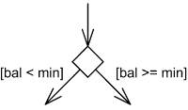
Choice/Decision
Choice realizes a dynamic conditional branch. It evaluates the guards of the triggers of its outgoing transitions to select only one outgoing transition.
A choice state is shown as a diamond-shaped symbol.
BSSE (Software Engineering-I) SZABIST-Islamabad

Slide 13
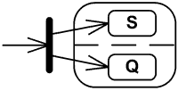
Fork
Fork serve to split an incoming transition into two or more transitions terminating on orthogonal target vertices (i.e., vertices in different regions of a composite state). The segments outgoing from a fork vertex must not have guards or triggers.
The notation for a fork is a short heavy bar. The bar may have one or more arrows from the bar to states. A transition string may be shown near the bar.
BSSE (Software Engineering-I) SZABIST-Islamabad

Slide 14

Join
Join merges several transitions originating from source vertices in different orthogonal regions. The transitions entering a join vertex cannot have guards or triggers.
The notation for a join is a short heavy bar. The bar may have one or more arrows from source states to the bar. A transition string may be shown near the bar.
BSSE (Software Engineering-I) SZABIST-Islamabad

Slide 15

Final State
Final state is a special kind of state signifying that the enclosing region is completed. If the enclosing region is directly contained in a state machine and all other regions in the state machine also are completed, then it means that the entire state machine is completed.
A final state is shown as a circle surrounding a small solid filled circle.
BSSE (Software Engineering-I) SZABIST-Islamabad

Slide 16
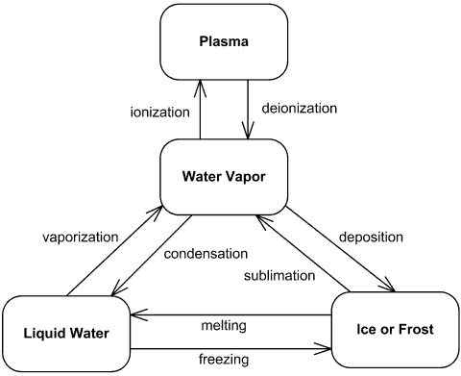
State Machine Example - Water Phase Diagram
BSSE (Software Engineering-I) SZABIST-Islamabad

Slide 17
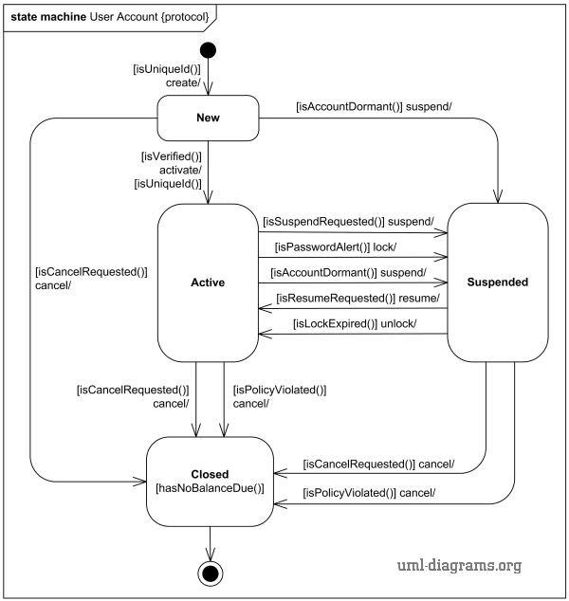
State Machine Example – Online Shopping

Slide 18
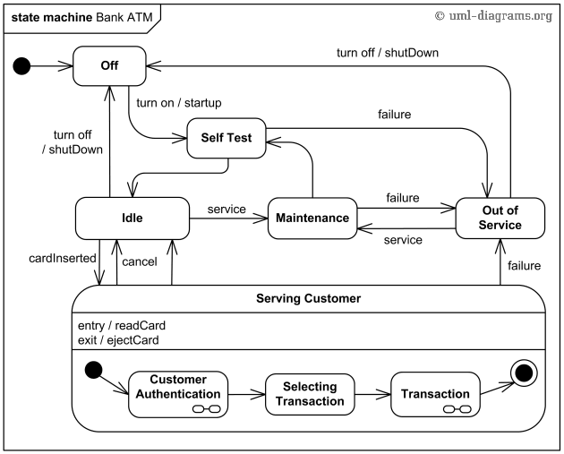
State Machine Example - Bank ATM
BSSE (Software Engineering-I) SZABIST-Islamabad

Slide 19
State Diagram Representation
Table: Tables are also an effective way of expressing information about states and events as illustrated in 1 state transition table. Tables can be created with the table editor much like filling in cells of a spreadsheet. Tables can be generated automatically from information in a state diagram.
Tables are often combined with data flow diagrams to control when processes are active or to generate output control flows from input control flows.
State | Event | Action | Next State
Lock | key detected | key turned | Unlock
unlock | key detected | key turned | lock
BSSE (Software Engineering-I) SZABIST-Islamabad

Slide 20
State Diagram Representation
Table: Coin Dispensing Machine
State | Event | Action | Next State
Wait for Bill | Bill Detected | Load Bill | Verify Bill
Verify Bill | Verification Failed | Reject Bill | Wait for Bill
Verify Bill | Verification Passed | Dispense Coin | Dispensing Coin
BSSE (Software Engineering-I) SZABIST-Islamabad

